Slide 1
CIs 2403-object oriented programming
Chapter 5
Understanding composition between classes/objects with the use of UML.
CHAPTER 5 | CLO2: Implement different types of relationships (Association, Aggregation, Composition) between classes to develop object-oriented solutions.

Slide 2
Document Revision CONTROL (DRC)
Version​ | Author​ | Effective Date​ | Change Description​ | DRC No​
1.0​ | Dr Madeleine Togher​ | Sept 2021 | Define the first version​ | 001​
1.1​
2.0​
X: Major change

Slide 3
Lecture Notes
Contents of lectures are based on the textbook, recommended text, and supplementary material
Please read Chapter ??? from page
??? to ???
??? to ???

Slide 4
Lecture OUTLINE
1. INTRODUCTION
KAHOOT!QUIZ
2. WHAT IS COMPOSITION?
3. 1:1 COMPOSITION
KEY TERMS
4. WHEN TO USE COMPOSITION OR AGGREGATION

Slide 5
LECTURE OBJECTIVES
At the end of lecture, the student should be able to:
Understand the concept of Composition between related classes
Implement Composition in Java
Implement 1:1 Composition in Java

Slide 6
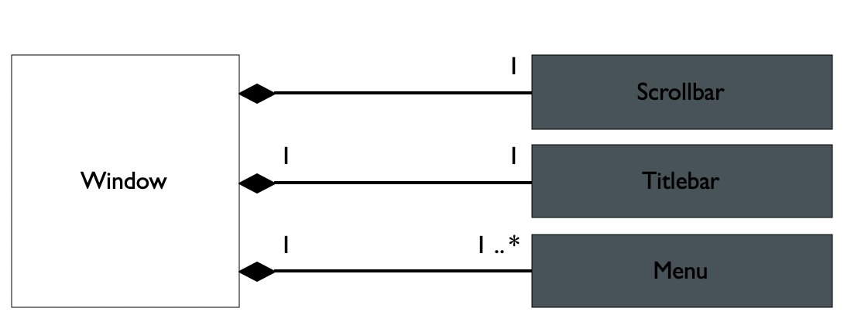
Introduction
A composition indicates
A physical/strong whole-part relationship between a whole and a constituent part
Where the part can’t exist independently from the whole (i.e., they live and die as a whole)
Compositions are denoted by a filled-diamond added onto the association
Relationship Types
Dependency
Generalization/Specialization
Association
Aggregation
Composition
whole
Parts

Slide 7
When TO USE Composition?...
Aggregation to Composition
We can transform aggregation into composition, we need to check the following rules:
Rule 1: Check the multiplicity on the the top of the diamond
Rule 2: Check the life dependency between the whole and part
if there is a life dependency between the whole and part then transform it into composition,
otherwise keep it as an aggregation
if it is 0..n or 1..n then it can’t be transformed into composition
otherwise, if it is (0..1 and 1..1) check Rule 2

Slide 8
WHEN TO USE composition?
Composition implies a relationship where one class cannot exist without another related class.
Example: House class and related Room class. Rooms don't exist separately without a House. Rooms don’t exist on their own.
We should use composition in cases where there's a much stronger lifecycle dependency between the two objects, meaning that when class House is deleted then the related class Room is also deleted as a result.

Slide 9
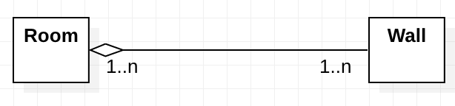
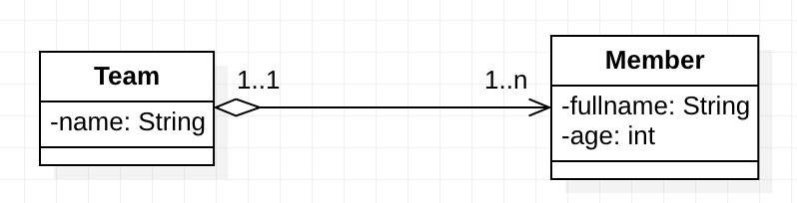
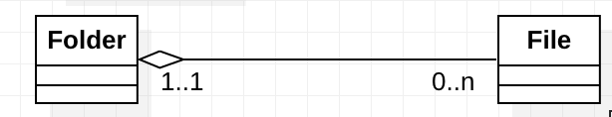
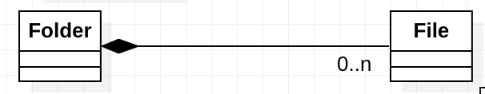
When to USE COMPOSITION?-Example
With reference to the below class diagrams, could you transform the aggregations into compositions?
UML Class Diagram | Yes/No
 | No, it is not a composition. The multiplicity on the the top of the diamond is 1..n. So, we cannot transform it into composition
 | No, it is not a composition. Eventhough the multiplicity on the the top of the diamond is 1..1, there is no life dependency between Team and Member. Members can exist separately without a Team.
 | Yes, it shall be a composition. The multiplicity on the the top of the diamond is 1..1 and there is a life dependency between Folder and Files (if a folder is destroyed, all its files are destroyed)
Notes:
There is no need to specify the multiplicity on the top of the filled diamond, because it should be either 0..1 or 1..1

Slide 10
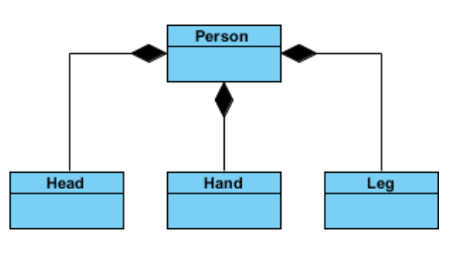
Composition-ExamplEs
Very Simple Composition Example
If the person class (whole object) instance is deleted, then the associated (part object) Head, Hand and Leg instances will be also deleted

Slide 11
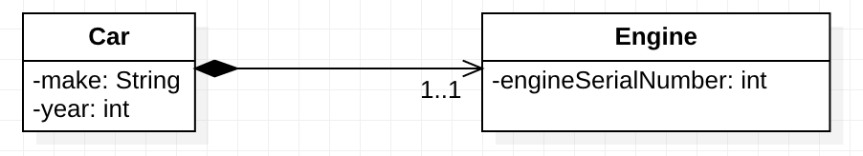
composition
To enforce a composition relationship, we need to make sure that the part object is still accessible but only by the whole object, which means that:
The part object (Engine) must be created inside the whole object (Car)
This can be done either inside the whole object constructor, as part of a static block.
The instance variable that holds the part object must be private
There is no getter/setter for accessing the part directly (there is no way an outside object has access to the part object - Engine)

Slide 12
3. 1:1 composition
In this example, a Car object relates in a one to one relationship with an Engine object.
A Car has one Engine only
Note: If an object instance of class Car is deleted, the instance of class Engine will not exist due to the strong dependency

Slide 13
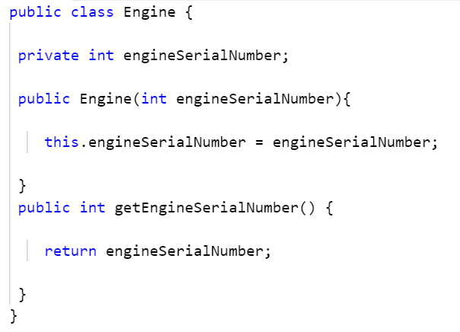
3. 1:1 composition
Create the Engine class first as it holds no reference and is the most simple of the two classes in the diagram
Engine.java

Slide 14
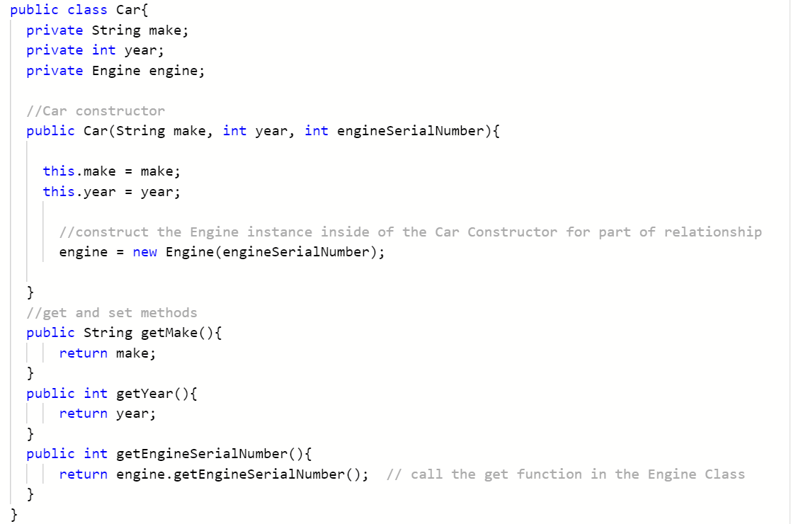
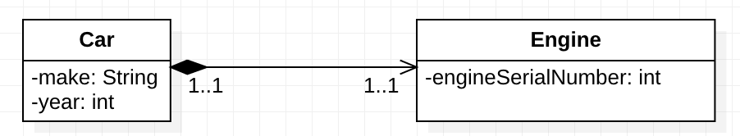
3. 1:1 Association – Unidirectional - coding
Implement the Car class next as it holds a 1:1 reference to the Engine class which is already implemented.
The Engine object instance is created inside the Car constructor, modelling the strong has–a relationship.
Car.java
Notes:
// the Engine object is created inside the car object and its argument was also passed in first as an argument to the Car object
// When this Car object is destroyed, the Engine object will also be destroyed and will no longer be available.
// If the instance of Car is garbage collected the strongly associated instance of Engine will also be garbage collected.

Slide 15
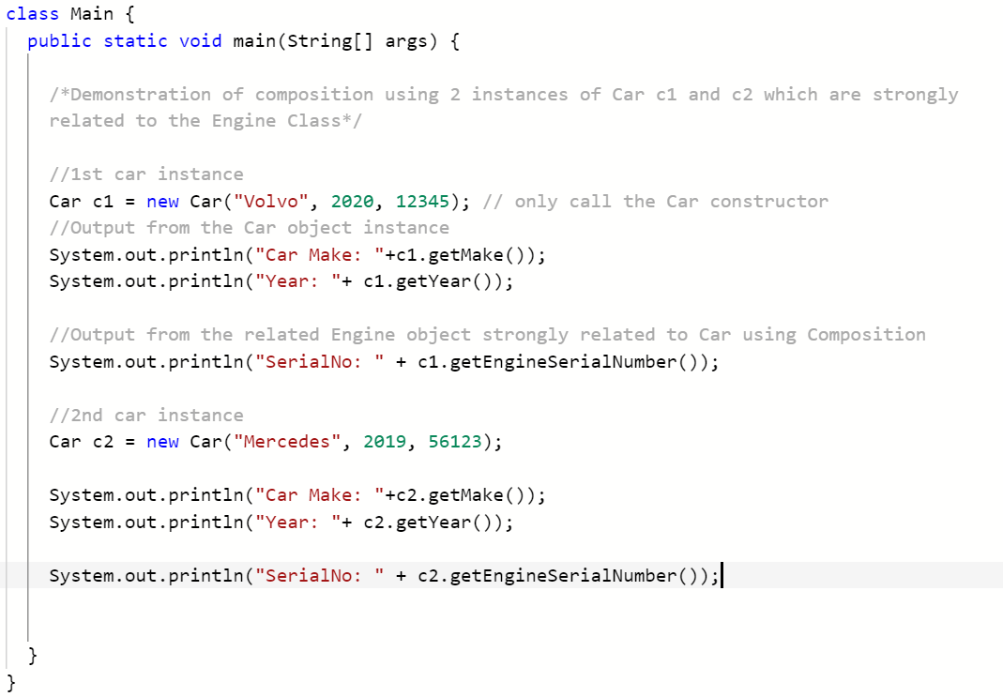
3. 1:1 Association – Unidirectional - coding
Now test the classes associated using 1:1 composition by implementing the Main driver class below:
Main.java
Output

Slide 16
KEY TERMS
Composition
Life Dependency

Slide 17


